Slide 1



Rules of migration for foreign students of the Sevastopol State University

Slide 2

Upon arriving in Russia, you will have the following responsibilities
Registration (register by place of residence: Governamental dormitory or rental apartment or hostel)
EXTENSION OF STUDY VISA
Medical examination (Medical examination for further mandatory Dactyloscopy)
Dactyloscopy
Medical insurance
SIM CARD REGISTRATION

Slide 3

Registration
Initial registration at the place of residence within 7 working days from the moment of crossing the border with Russia
(including weekends and holidays)
Re-registration at the place of residence within
3 working days (including weekends and holidays)

Slide 4
Register at the place of residence:
Once you reach Sevastopol, you have to IMMEDIATELY arrive at 33 Univresitetskaya Street,
B-304
For initial registration, you need to bring:
Migration card
Passport by which you entered Russia

Slide 5
if you are renting accommodation, you need:
As soon as you start renting an apartment/room in hostel, the owner of the apartment /hostel will also have to make registration for you.
In order for your apartment owner to successfully make registration, you need:
on the site SEVSU.RU Order copy of enrollment order from your University
Come to 33 Univresitetskaya Street, office B-304 (Directorate of International Cooperation) and take the Petition for Registration

Slide 6

If you plan to travel around Russia, you need:
Three days before the scheduled date of departure, you must arrive at the University
(B-304) and submit a request to be removed from your migration records.
Along with the application, you also give the specialists a copy of the return tickets.
When you come to another city in Russia, you are required to register within 3 working days (hotel or hostel).
Once you register in another city, you must keep the notification.
When you return to Sevastopol, you must definitely come to the University (B-304) within 3 working days.
and be registered again in the dormitory.
(Bring with you: saved registration from another city, passport, migration card, medical certificates)

Slide 7

SUBMIT THE DOCUMENTS 45 DAYS BEFORE THE EXPIRATION OF YOUR VISA!
Required documents for VISA EXTENSION
Passport + notarized translation into Russian
+ registration notification
+ migration card
Certificates obtained after a medical examination (drug doctor, certificate of absence of HIV infection, medical conclusion)
state fee 6000 rub.
1 photo 3*4 (70% Face appearance)
COPIES:
All passport pages
Migration card
notification of registration
Green card (Dactyloscopy)
Certificates obtained after a medical examination (drug doctor, certificate of absence of HIV infection, medical conclusion)

Slide 8
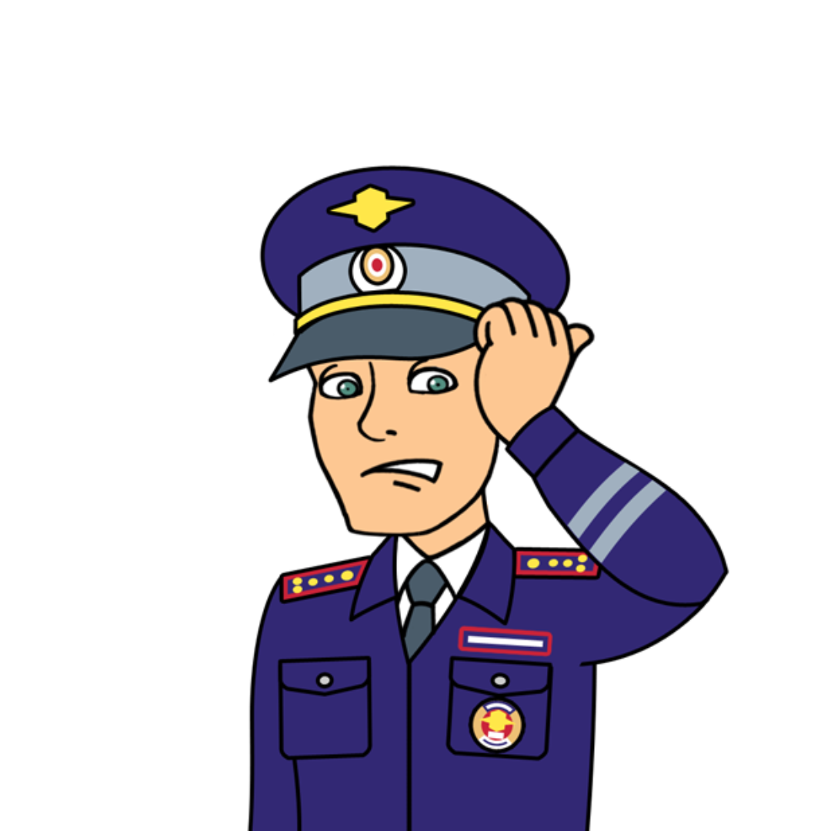
Dactyloscopy
Dactyloscopy should be done within 30 calendar days
All foreign citizens who have come to Russia to study must undergo the Dactyloscopic examination procedure
Location:
- Parshina street 29
- Vosstavshikh Square

Slide 9

Necessary documents for conducting the Dactyloscopic examination
MATURE STUDENTS
Passport + notarised translation into Russian
+ registration notification
+ migration card
Certificates obtained after a medical examination (drug doctor, certificate of absence of HIV infection, medical conclusion)

Slide 10
Required documents for conducting dactyloscopic examination for
MINOR STUDENTS
Passport + notarized translation into Russian
+ registration notification
+ migration card
Certificates obtained after a medical examination (drug doctor, certificate of absence of HIV infection, medical conclusion)
Power of attorney from parents to a representative in Russia to represent interests in the Federal Migration Service and in polyclinics during medical examinations
(the power of attorney must be issued in the origin country and notarized into Russian language)

Slide 11
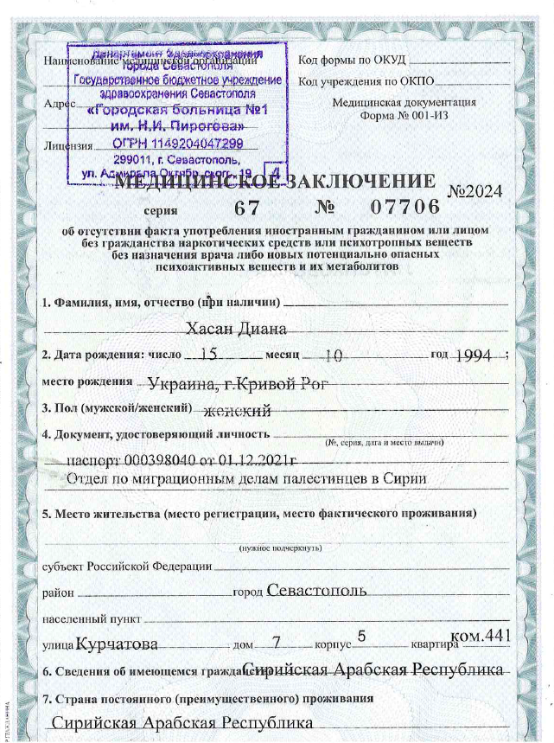
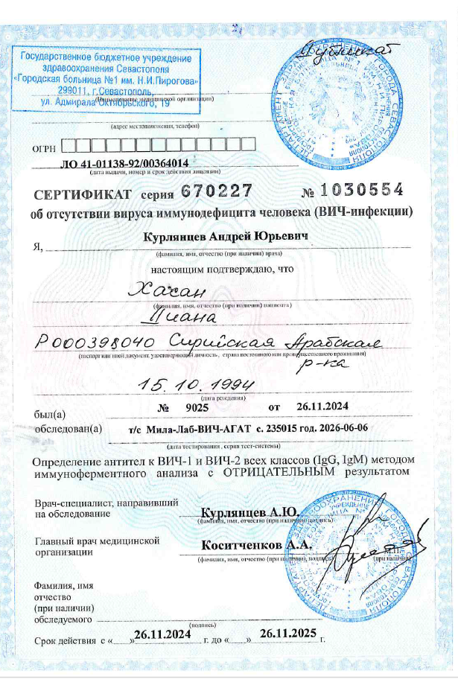
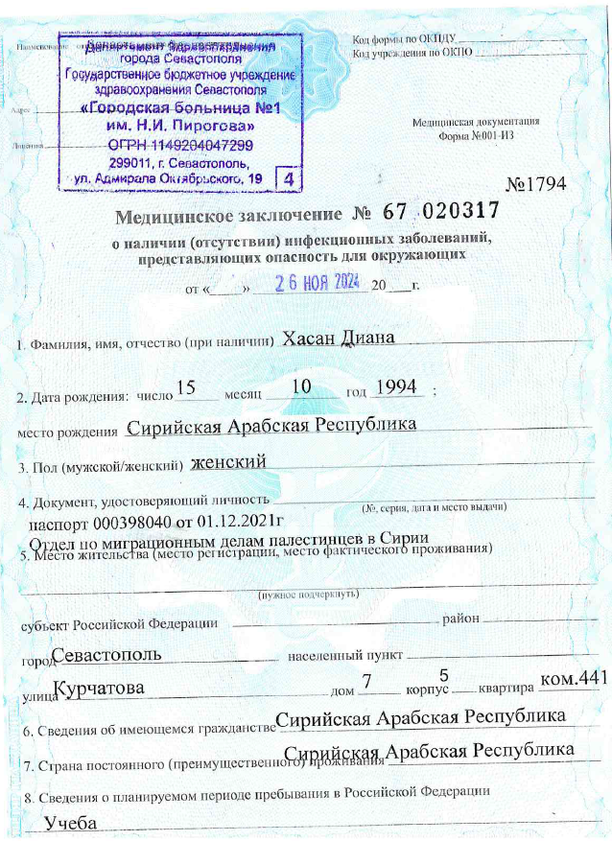
Example of medical certificates

Slide 12

Contacts for booking an appointment with a medical organization and the Migration Office
MATURE STUDENTS
Sevastopol,
4 Boris Mikhailov Street, office 201
Tue. and Thu.
Miner students
Sevastopol, 20 Lenin Street
Sevastopol, 19G Yumashev Street
FOR DACTYLOSCOPY RECORDING:
+7869273-82-16
from 09.00 to 17.00

Slide 13

What are the prices?
Medical check-up
8900 rub
Dactyloscopy
3300 rub
State fee for a visa 6000 rub.
Fee for registration (Governmental dormitory )
FROM 850 RUB
TO 1350 RUB
Medical insurance
FROM 4000 RUB

Slide 14

Let's repeat the IMPORTANT deadlines
7 working days for submission of registration documents (starting from the date of crossing the border)
3 working days for re-registration if you went to another city in Russia during your studies
30 calendar days from the date of arrival in Russia to undergo a medical examination and Dactyloscopy
SUBMIT THE DOCUMENTS 45 DAYS BEFORE THE EXPIRATION OF YOUR VISA!

Slide 15
Let's review the important deadlines for senior students
7 working days for submission of registration documents (starting from the date of crossing the border)
3 working days for re-registration if you went to another city in Russia during your studies
30 calendar days before the end of the old medical certificates, make new medical examination and submit copies of the new certificates to the office
B-304
SUBMIT THE DOCUMENTS 45 DAYS BEFORE THE EXPIRATION OF YOUR VISA!

Slide 16

Responsibility for time violations
Not submitted the registration document on time (missed the deadline)
1st and 2nd time: FINE 2000 rubles
3rd time: DEPORTATION
Failed to do medical check up and dactyloscopy within
30 days or failed to renew medical check up within 30 days
DEPORTATION
Failed to apply for visa extension and renewal DEPORTATION

Slide 17
SIM CARD REGISTRATION
Starting from January 1, 2025, foreign citizens can only apply for a SIM card using biometrics.
Prepare a notarized translation of your passport +migration card+ registration + green card (dactyloscopy)
We get the SNILS
How to do it?
Go to the Social Fund of the Russian Federation or the Multifunctional Center (My Documents)

Slide 18

Russian Social Fund addresses in Sevastopol:
299018,. Sevastopol, st. Urytskyi, d. 2
299008,. Sevastopol, st. Pozharova, d. 5
299003,. Sevastopol, st. Kievskaya, zd. 11
299007,. Sevastopol, st. N. Musicians, d. 60a
Working hours:
Monday - Thursday: from 09:00 to 18:00,
Friday: 9:00 to 16:45

Slide 19

Addresses of the My Documents MFC in Sevastopol – Northern Side:
24 Levanevskogo Street, Sevastopol
Working hours:
Monday: 09:00 - 18:00
Tuesday: 09:00 - 18:00
Wednesday: 09:00 - 18:00
Thursday: 10:00 - 20:00
Friday: 09:00 - 18:00
Saturday: 09:00 - 17:00
Sunday: OFF
1 Umrikhina Street, Inkerman
Working hours:
Monday: 09:00 - 18:00
Tuesday: 09:00 - 18:00
Wednesday: 09:00 - 18:00
Thursday : 09:00 - 18:00
Friday : 09:00 - 18:00
Saturday : OFF
Sunday : OFF

Slide 20

Visit the convenient branch of a bank or IFC, you will need:
Email
SNILES
Passport and its notarized translation
Migration card
Registration
Green card (dactyloscopy)
2. Create an account on the State Services website (GOSUSLUGI)
Your account will be verified on the same day

Slide 21
Visit the convenient branch of a bank or IFC, you will need:
- Email
- SNILES
- Passport and its notarized translation
- Migration card
- Registration
- Green card (dactyloscopy)
Verified account on GOSUSLUGI
3. Register your biometrics at a bank branch
The bank employee will take a photo of you and record your voice.
The biometrics status will be displayed on the GOSUSLUGI APP

Slide 22
Addresses of banks for biometric registration in Sevastopol (currently Sberbank)
Sevastopol, Rudneva St., 13/31
Sevastopol, ave. 80 General Ostryakova Street
Sevastopol, ave. October Revolution, 38/12
Sevastopol, General Khryukin St., 2
Sevastopol, Lenin St., 39

Slide 23
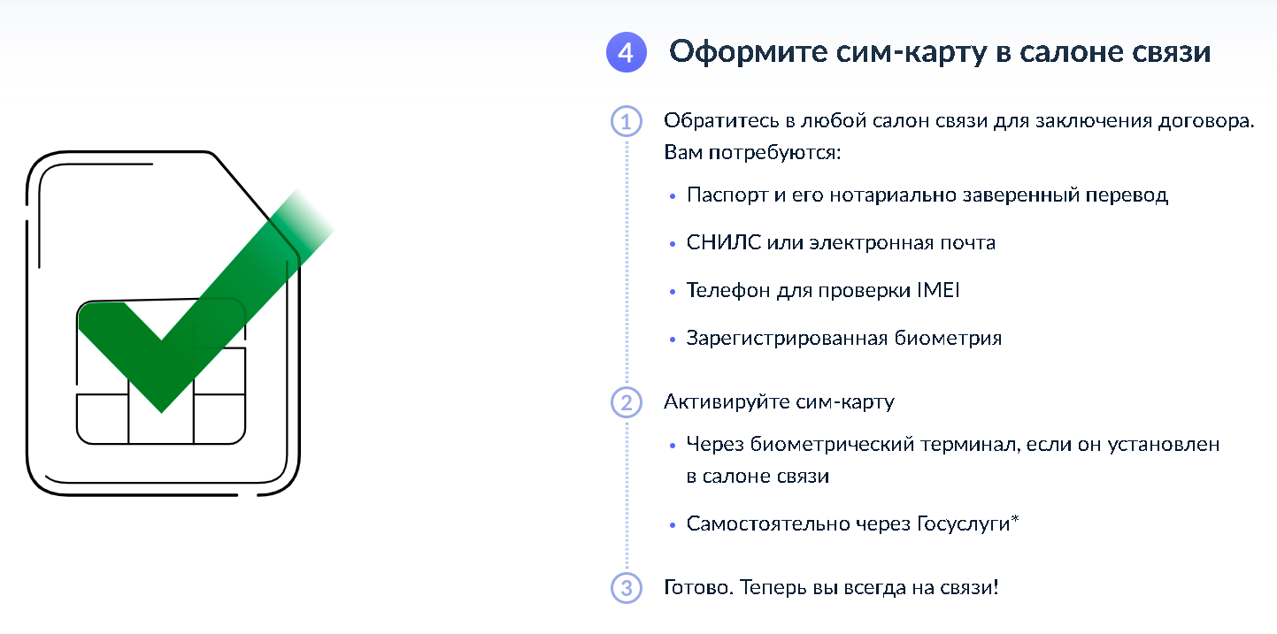
To issue a new SIM card, contact your mobile operator's office.
What you will need?
A foreign citizen's passport (Notarized translation of the passport
into Russian)
SNILS
Verified account on GOSUSLUGI
Verified biometrics
The email address that you have access to
The IMEI of the device where you plan to use the SIM card
The employee will draw up a contract — study and sign it.
Activate the SIM card at the operator's office or independently via GOSUSLUGI

Slide 24
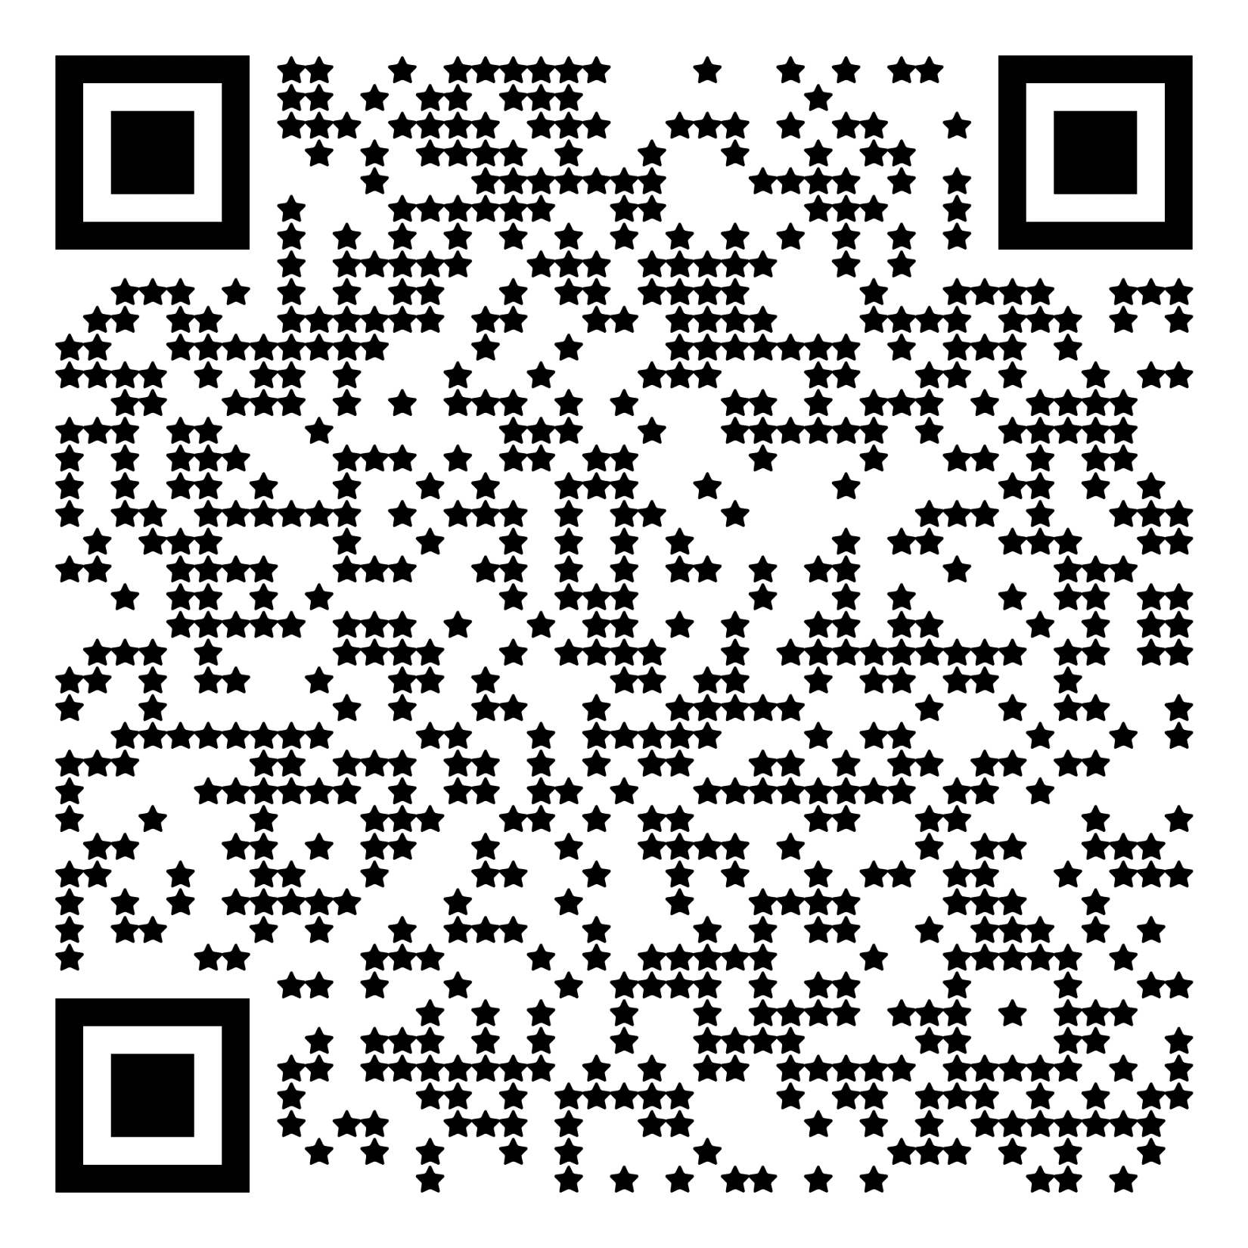
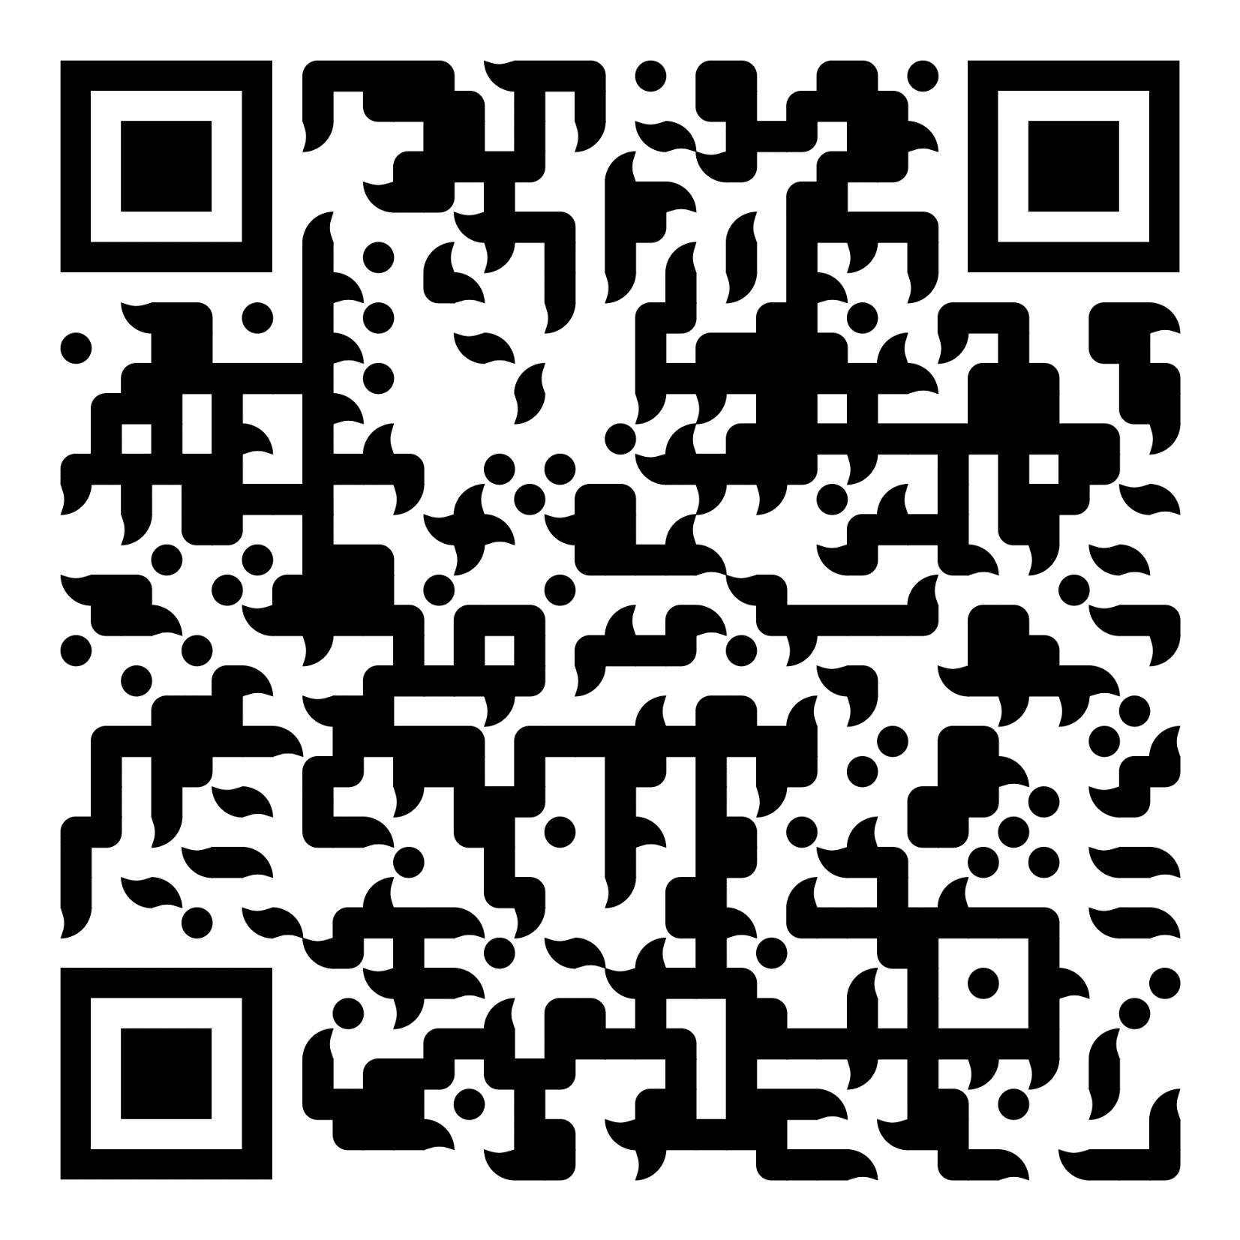
ЧАТ С ИНОСТРАННЫМИ
СТУДЕНТАМИ СЕВГУ
Contacts of the Directorate of International Cooperation:
Director of the Directorate of International Cooperation
Tsokur Elizaveta Grigorievna
egtsokur@sevsu.ru
Deputy Director of the Directorate of International Cooperation
Barashkin Sergey Vladimirovich
svbarashkin@sevsu.ru
ГРУППА
МЕЖДУНАРОДНОГО КЛУБА ДРУЖБЫ
ГОРОДА СЕВАСТОПОЛЯ ВКонтакте

